Slide 1

236781
Lecture 8
Deep learning
Large language models
Dr. Chaim Baskin

Slide 2
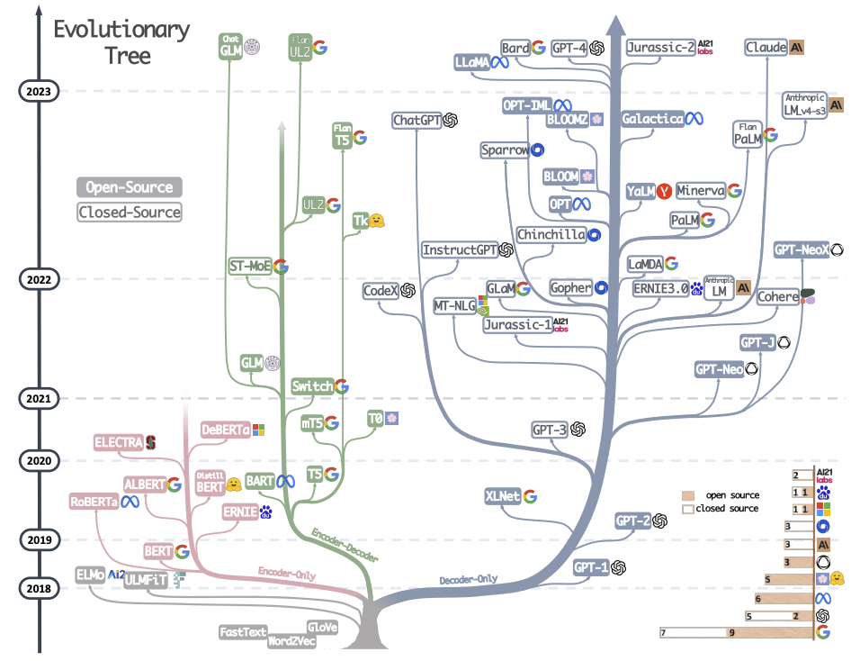
Large language models
Source

Slide 3
Self-supervised language modeling with transformers
Download A LOT of text from the internet
Train a giant transformer using a suitable pretext task
Fine-tune the transformer on desired NLP task (optional)

Slide 4
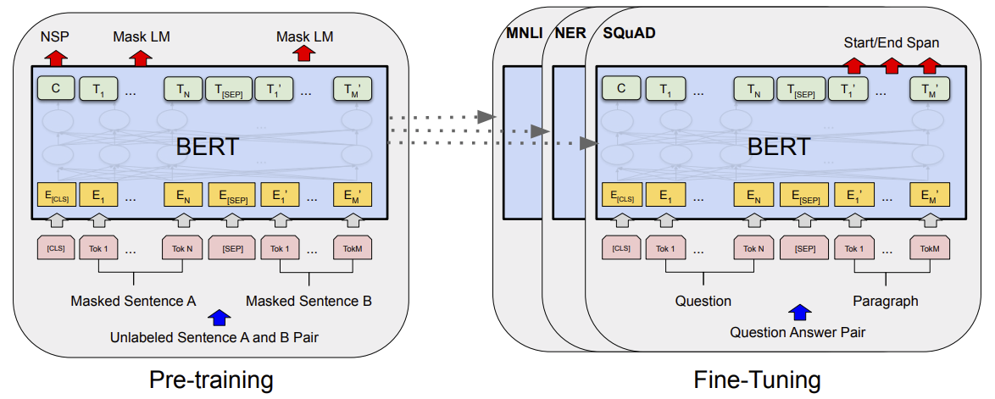
Bidirectional encoder representations from transformers (BERT)
J. Devlin, M.-W. Chang, K. Lee, K. Toutanova, BERT: Pre-training of Deep Bidirectional Transformers for Language Understanding, EMNLP 2018

Slide 5
BERT: Pretext tasks
Masked language model (MLM)
Randomly mask 15% of tokens in input sentences, goal is to reconstruct them using bidirectional context
Image source

Slide 6
BERT: Pretext tasks
Next sentence prediction (NSP)
Useful for Question Answering and Natural Language Inference tasks
In the training data, 50% of the time B is the actual sentence that follows A (labeled as IsNext), and 50% of the time it is a random sentence (labeled as NotNext).
Predict likelihood that sentence B belongs after sentence A
Image source

Slide 7
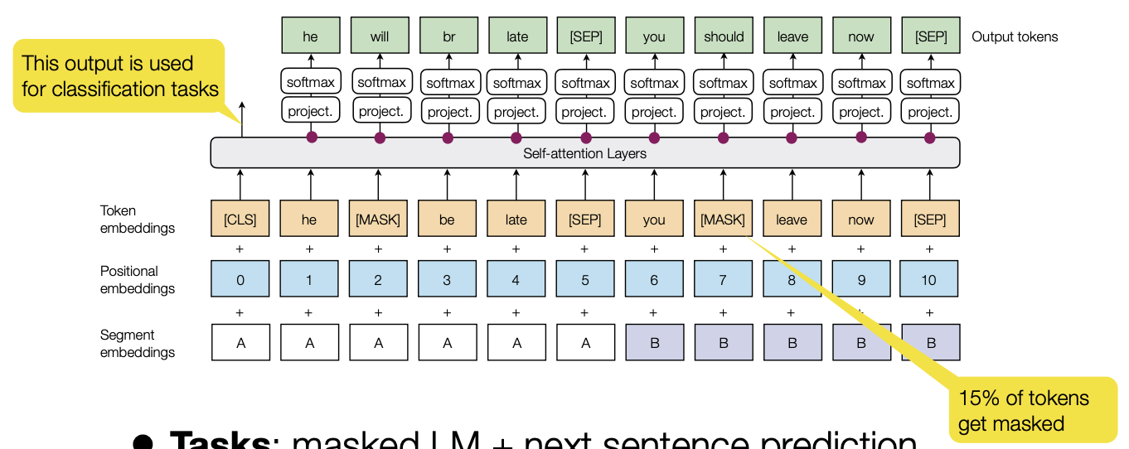
BERT: More detailed view
WordPiece (from GNMT)
Trained on Wikipedia (2.5B words) + BookCorpus (800M words)
Image source

Slide 8
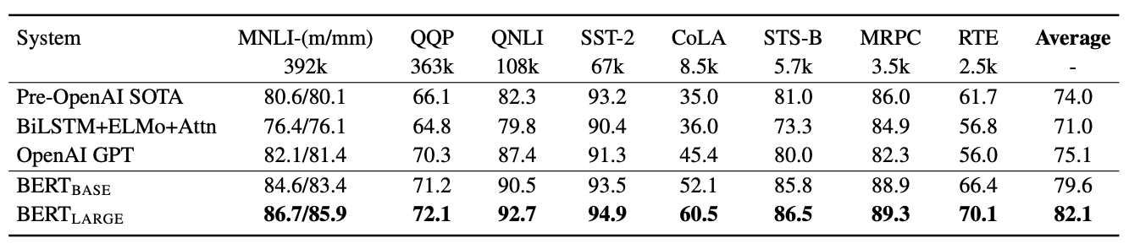
BERT: Evaluation
General Language Understanding Evaluation (GLUE) benchmark (gluebenchmark.com)

Slide 9
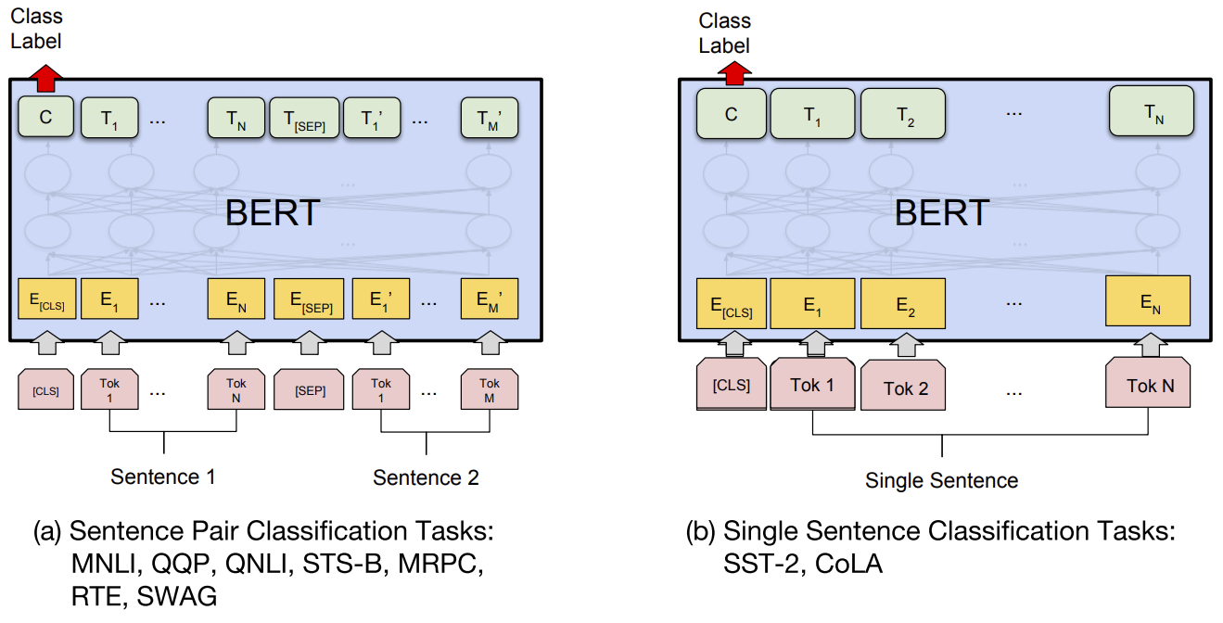
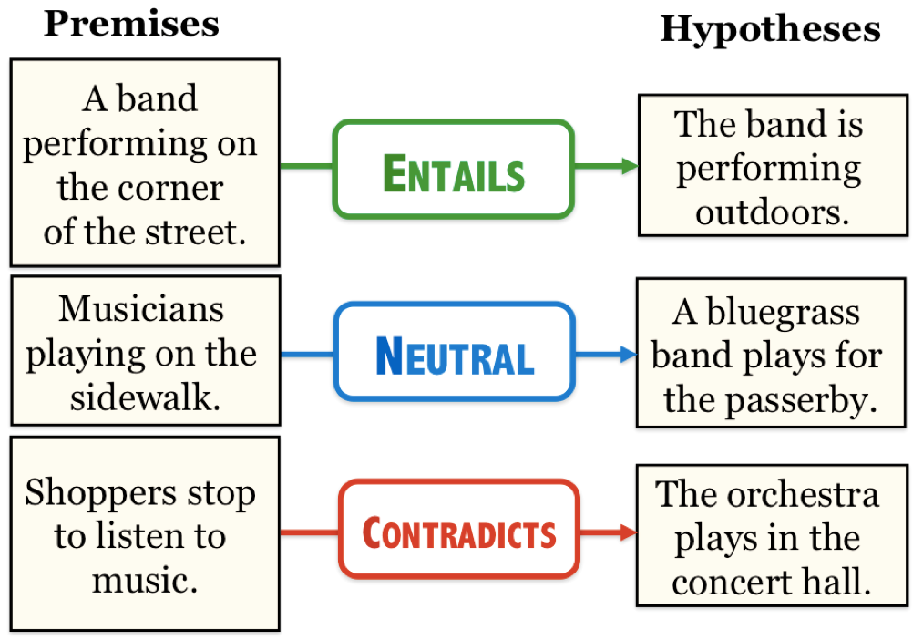
BERT: Downstream tasks
Textual entailment
Source: J. Hockenmaier
Entailment, textual equivalence and similarity

Slide 10
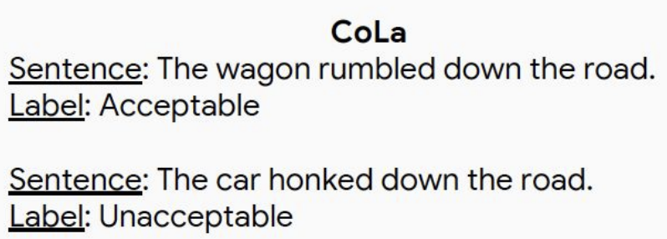
BERT: Downstream tasks
Sentiment classification, linguistic acceptability
Image source

Slide 11
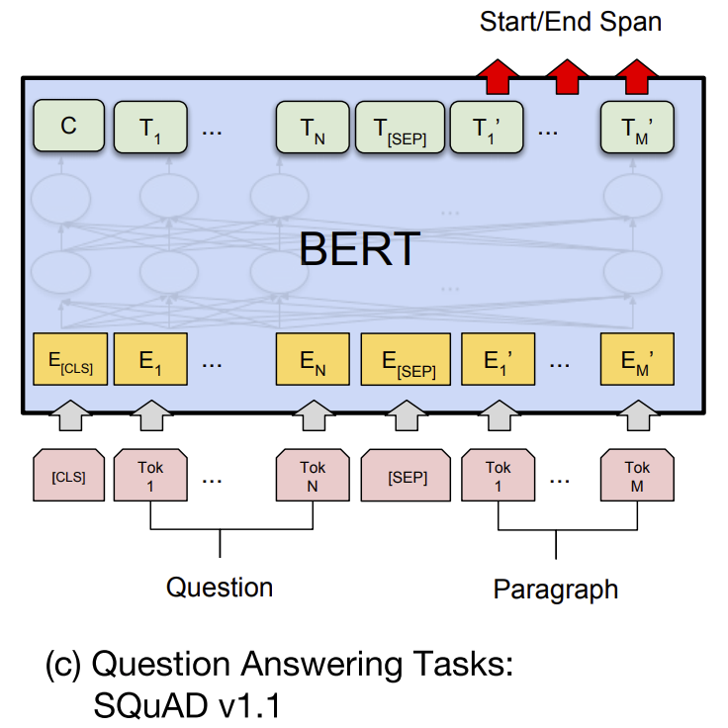
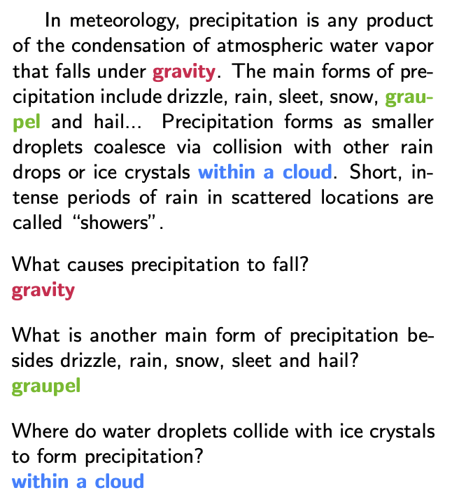
BERT: Downstream tasks
Find span in paragraph that contains the answer
Source: SQuAD v1.1 paper

Slide 12
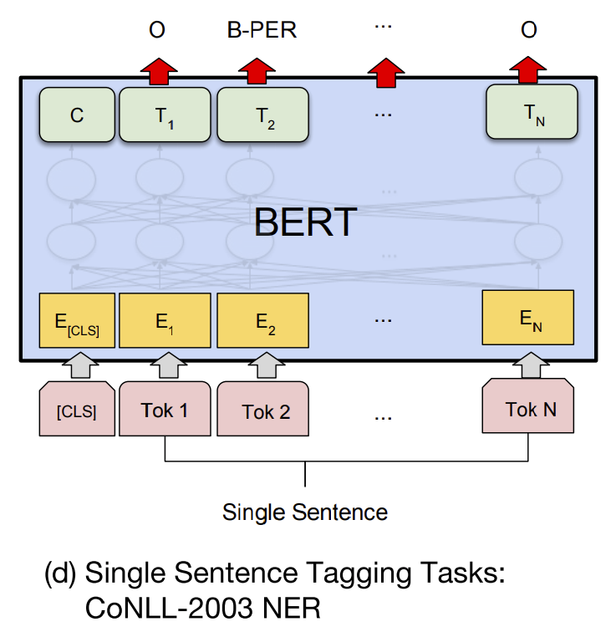
BERT: Downstream tasks
Image source
Named entity recognition

Slide 13
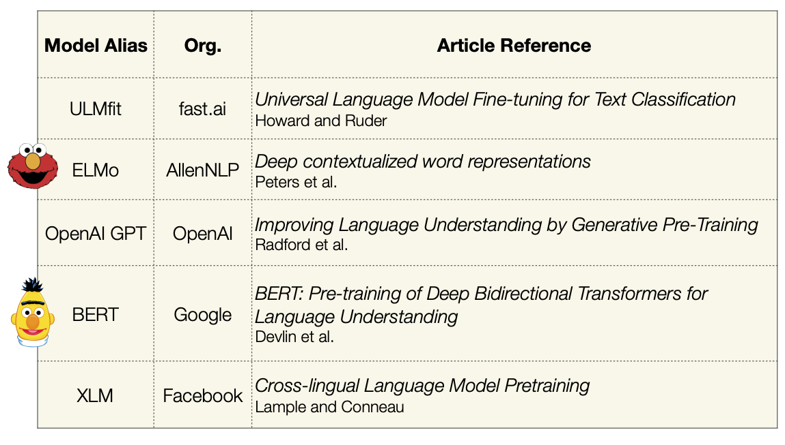
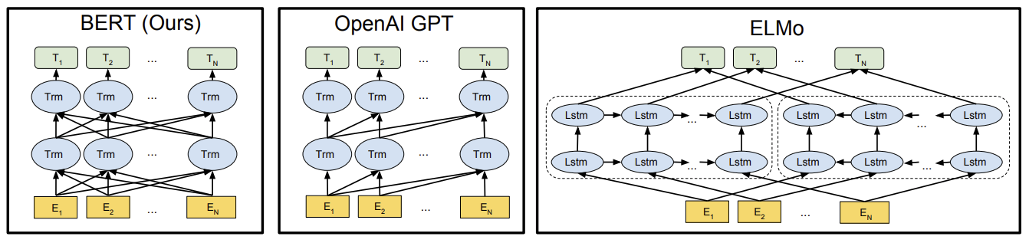
Other early language models
Image source

Slide 14
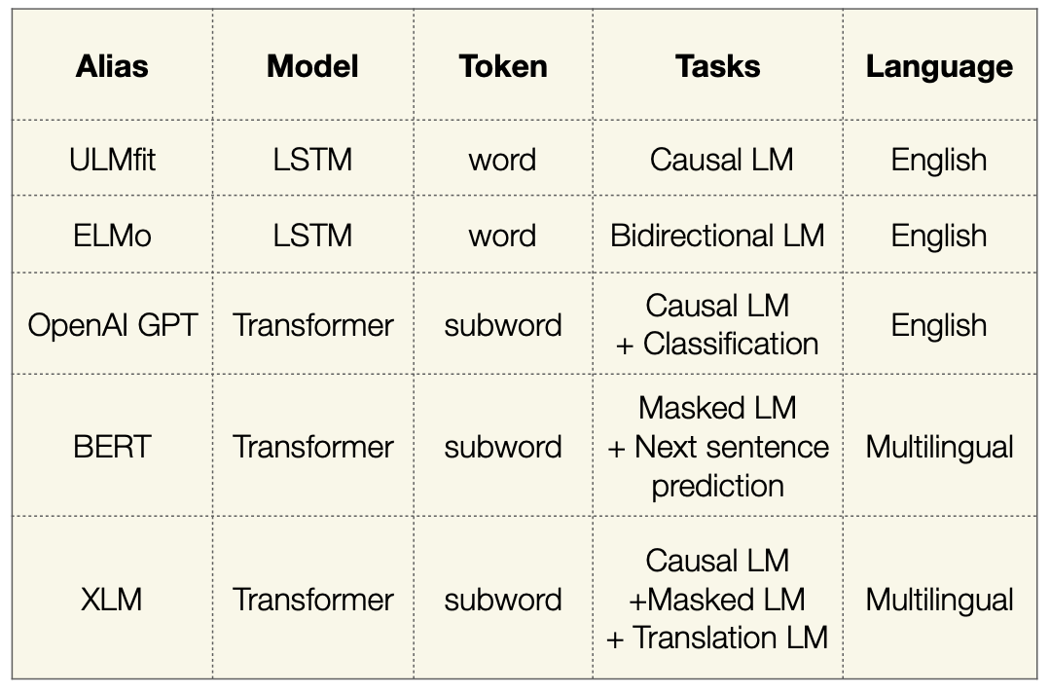
Other early language models
Image source

Slide 15
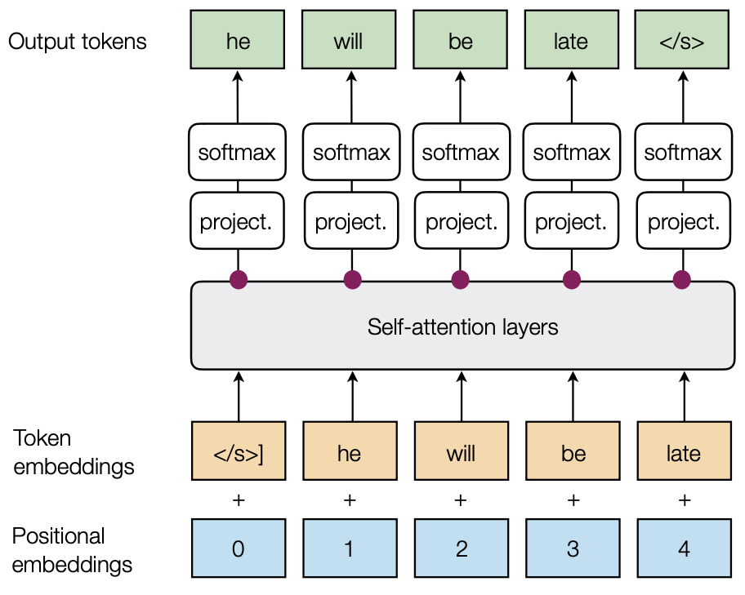
OpenAI GPT (Generative Pre-Training)
Pre-training task: next token prediction (causal language modeling)
A. Radford et al. Improving language understanding by generative pre-training. 2018
Image source

Slide 16
Scaling up transformers
Source: J. Johnson
Model | Layers | Hidden dim. | Heads | Params | Data | Training
Transformer-Base | 12 | 512 | 8 | 65M |  | 8x P100 (12 hours)
Transformer-Large | 12 | 1024 | 16 | 213M |  | 8x P100 (3.5 days)
Vaswani et al. Attention is all you need. NeurIPS 2017 (Google)

Slide 17
Scaling up transformers
Source: J. Johnson
Model | Layers | Hidden dim. | Heads | Params | Data | Training
Transformer-Base | 12 | 512 | 8 | 65M |  | 8x P100 (12 hours)
Transformer-Large | 12 | 1024 | 16 | 213M |  | 8x P100 (3.5 days)
BERT-Base | 12 | 768 | 12 | 110M | 13 GB | 4x TPU (4 days)
BERT-Large | 24 | 1024 | 16 | 340M | 13 GB | 16x TPU (4 days)
Devlin et al. BERT: Pre-training of Deep Bidirectional Transformers for Language Understanding. EMNLP 2018 (Google)

Slide 18
Scaling up transformers
Source: J. Johnson
Model | Layers | Hidden dim. | Heads | Params | Data | Training
Transformer-Base | 12 | 512 | 8 | 65M |  | 8x P100 (12 hours)
Transformer-Large | 12 | 1024 | 16 | 213M |  | 8x P100 (3.5 days)
BERT-Base | 12 | 768 | 12 | 110M | 13 GB | 4x TPU (4 days)
BERT-Large | 24 | 1024 | 16 | 340M | 13 GB | 16x TPU (4 days)
XLNet-Large | 24 | 1024 | 16 | ~340M | 126 GB | 512x TPU-v3 (2.5 days)
RoBERTa | 24 | 1024 | 16 | 355M | 160 GB | 1024x V100 GPU (1 day)
Yang et al. XLNet: Generalized Autoregressive Pretraining for Language Understanding. 2019 (Google, CMU)
Liu et al. RoBERTa: A Robustly Optimized BERT Pretraining Approach. 2019 (FAIR, UW)

Slide 19
Scaling up transformers
Source: J. Johnson
Model | Layers | Hidden dim. | Heads | Params | Data | Training
Transformer-Base | 12 | 512 | 8 | 65M |  | 8x P100 (12 hours)
Transformer-Large | 12 | 1024 | 16 | 213M |  | 8x P100 (3.5 days)
BERT-Base | 12 | 768 | 12 | 110M | 13 GB | 4x TPU (4 days)
BERT-Large | 24 | 1024 | 16 | 340M | 13 GB | 16x TPU (4 days)
XLNet-Large | 24 | 1024 | 16 | ~340M | 126 GB | 512x TPU-v3 (2.5 days)
RoBERTa | 24 | 1024 | 16 | 355M | 160 GB | 1024x V100 GPU (1 day)
GPT-2 | 48 | 1600 | ? | 1.5B | 40 GB
Radford et al. Language models are unsupervised multitask learners. 2019 (OpenAI)

Slide 20
Scaling up transformers
Source: J. Johnson
Model | Layers | Hidden dim. | Heads | Params | Data | Training
Transformer-Base | 12 | 512 | 8 | 65M |  | 8x P100 (12 hours)
Transformer-Large | 12 | 1024 | 16 | 213M |  | 8x P100 (3.5 days)
BERT-Base | 12 | 768 | 12 | 110M | 13 GB | 4x TPU (4 days)
BERT-Large | 24 | 1024 | 16 | 340M | 13 GB | 16x TPU (4 days)
XLNet-Large | 24 | 1024 | 16 | ~340M | 126 GB | 512x TPU-v3 (2.5 days)
RoBERTa | 24 | 1024 | 16 | 355M | 160 GB | 1024x V100 GPU (1 day)
GPT-2 | 48 | 1600 | ? | 1.5B | 40 GB
Megatron-LM | 72 | 3072 | 32 | 8.3B | 174 GB | 512x V100 GPU (9 days)
~$430,000 on Amazon AWS
Shoeybi et al. Megatron-LM: Training Multi-Billion Parameter Languge Models using Model Parallelism. 2019 (NVIDIA)

Slide 21
Scaling up transformers
Source: J. Johnson
Model | Layers | Hidden dim. | Heads | Params | Data | Training
Transformer-Base | 12 | 512 | 8 | 65M |  | 8x P100 (12 hours)
Transformer-Large | 12 | 1024 | 16 | 213M |  | 8x P100 (3.5 days)
BERT-Base | 12 | 768 | 12 | 110M | 13 GB | 4x TPU (4 days)
BERT-Large | 24 | 1024 | 16 | 340M | 13 GB | 16x TPU (4 days)
XLNet-Large | 24 | 1024 | 16 | ~340M | 126 GB | 512x TPU-v3 (2.5 days)
RoBERTa | 24 | 1024 | 16 | 355M | 160 GB | 1024x V100 GPU (1 day)
GPT-2 | 48 | 1600 | ? | 1.5B | 40 GB
Megatron-LM | 72 | 3072 | 32 | 8.3B | 174 GB | 512x V100 GPU (9 days)
Turing-NLG | 78 | 4256 | 28 | 17B | ? | 256x V100 GPU
Microsoft. Turing-NLG: A 17-billion parameter language model by Microsoft. 2020

Slide 22
Scaling up transformers
Source: J. Johnson
Model | Layers | Hidden dim. | Heads | Params | Data | Training
Transformer-Base | 12 | 512 | 8 | 65M |  | 8x P100 (12 hours)
Transformer-Large | 12 | 1024 | 16 | 213M |  | 8x P100 (3.5 days)
BERT-Base | 12 | 768 | 12 | 110M | 13 GB | 4x TPU (4 days)
BERT-Large | 24 | 1024 | 16 | 340M | 13 GB | 16x TPU (4 days)
XLNet-Large | 24 | 1024 | 16 | ~340M | 126 GB | 512x TPU-v3 (2.5 days)
RoBERTa | 24 | 1024 | 16 | 355M | 160 GB | 1024x V100 GPU (1 day)
GPT-2 | 48 | 1600 | ? | 1.5B | 40 GB
Megatron-LM | 72 | 3072 | 32 | 8.3B | 174 GB | 512x V100 GPU (9 days)
Turing-NLG | 78 | 4256 | 28 | 17B | ? | 256x V100 GPU
GPT-3 | 96 | 12288 | 96 | 175B | 694 GB | ?
~$4.6M, 355 GPU-years
(source)
Brown et al. Language Models are Few-Shot Learners. NeurIPS 2020 (OpenAI)

Slide 23
Scaling up transformers
Source: J. Johnson
Model | Layers | Hidden dim. | Heads | Params | Data | Training
Transformer-Base | 12 | 512 | 8 | 65M |  | 8x P100 (12 hours)
Transformer-Large | 12 | 1024 | 16 | 213M |  | 8x P100 (3.5 days)
BERT-Base | 12 | 768 | 12 | 110M | 13 GB | 4x TPU (4 days)
BERT-Large | 24 | 1024 | 16 | 340M | 13 GB | 16x TPU (4 days)
XLNet-Large | 24 | 1024 | 16 | ~340M | 126 GB | 512x TPU-v3 (2.5 days)
RoBERTa | 24 | 1024 | 16 | 355M | 160 GB | 1024x V100 GPU (1 day)
GPT-2 | 48 | 1600 | ? | 1.5B | 40 GB
Megatron-LM | 72 | 3072 | 32 | 8.3B | 174 GB | 512x V100 GPU (9 days)
Turing-NLG | 78 | 4256 | 28 | 17B | ? | 256x V100 GPU
GPT-3 | 96 | 12,288 | 96 | 175B | 694 GB | ?
GOPHER | 80 | 16,384 | 128 | 280B | 10.55 TB | 4096x TPUv3 (38 days)
$3,768,320 on Google Cloud (eval price)
J. Rae et al. Scaling Language Models: Methods, Analysis, & Insights from Training Gopher. arXiv 2021 (DeepMind)

Slide 24
Scaling up transformers
Source: J. Johnson
Model | Layers | Hidden dim. | Heads | Params | Data | Training
Transformer-Base | 12 | 512 | 8 | 65M |  | 8x P100 (12 hours)
Transformer-Large | 12 | 1024 | 16 | 213M |  | 8x P100 (3.5 days)
BERT-Base | 12 | 768 | 12 | 110M | 13 GB | 4x TPU (4 days)
BERT-Large | 24 | 1024 | 16 | 340M | 13 GB | 16x TPU (4 days)
XLNet-Large | 24 | 1024 | 16 | ~340M | 126 GB | 512x TPU-v3 (2.5 days)
RoBERTa | 24 | 1024 | 16 | 355M | 160 GB | 1024x V100 GPU (1 day)
GPT-2 | 48 | 1600 | ? | 1.5B | 40 GB
Megatron-LM | 72 | 3072 | 32 | 8.3B | 174 GB | 512x V100 GPU (9 days)
Turing-NLG | 78 | 4256 | 28 | 17B | ? | 256x V100 GPU
GPT-3 | 96 | 12,288 | 96 | 175B | 694 GB | ?
GOPHER | 80 | 16,384 | 128 | 280B | 10.55 TB | 4096x TPUv3 (38 days)
PaLM | 118 | 18,432 | 48 | 540B | ? | 6144x TPUv4
A. Chowdhery et al. PaLM: Scaling Language Modeling with Pathways. arXiv 2022 (Google)

Slide 25
Source
(2013)

Slide 26
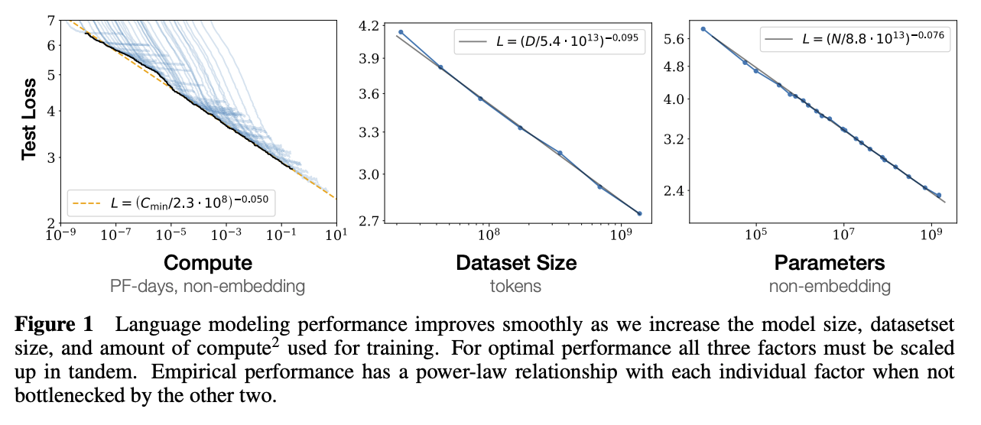
Scaling behavior of large language models
J. Kaplan et al. Scaling Laws for Neural Language Models. arXiv 2020

Slide 27
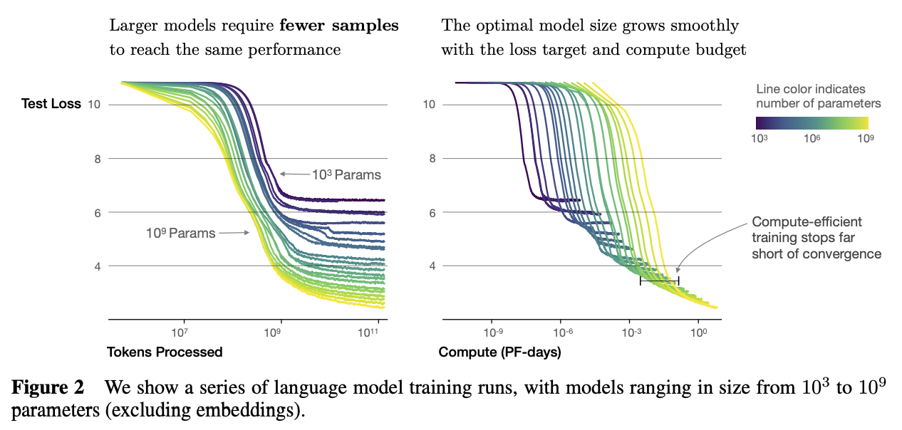
Scaling behavior of large language models
J. Kaplan et al. Scaling Laws for Neural Language Models. arXiv 2020

Slide 28
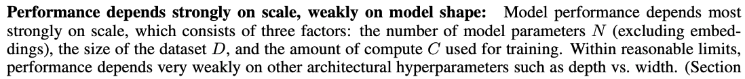
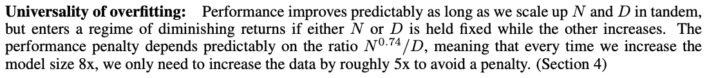
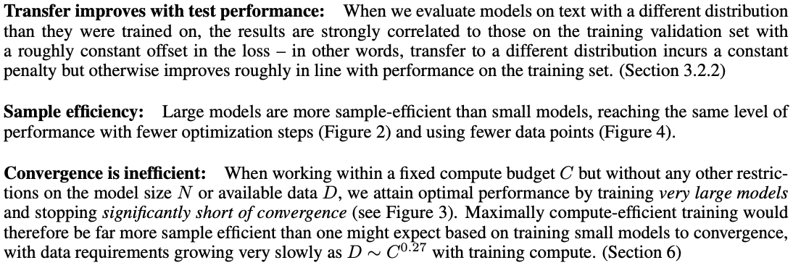
Scaling behavior of large language models
J. Kaplan et al. Scaling Laws for Neural Language Models. arXiv 2020

Slide 29
OpenAI GPT (Generative Pre-Training)
Pre-training task: next token prediction (causal language modeling)
A. Radford et al. Improving language understanding by generative pre-training. 2018
Image source

Slide 30
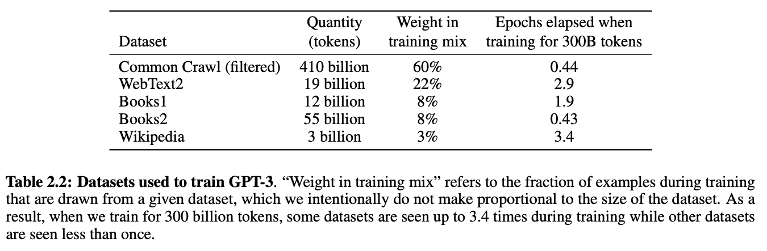
GPT-2 and GPT-3
Key idea: if the model and training datasets are big enough, model can adapt to new tasks without fine-tuning
Model | Layers | Hidden dim. | Heads | Params | Dataset
GPT-2 | 48 | 1600 | ? | 1.5B | WebText: 40GB
GPT-3 | 96 | 12288 | 96 | 175B | CommonCrawl (cleaned up): 694GB
GPT-2: A. Radford et al., Language models are unsupervised multitask learners, 2019
GPT-3: T. Brown et al., Language models are few-shot learners, NeurIPS 2020 (Best Paper Award)
Notes:
From the GPT-2 abstract: Natural language processing tasks, such as question answering, machine translation, reading comprehension, and summarization, are typically approached with supervised learning on task-specific datasets. We demonstrate that language models begin to learn these tasks without any explicit supervision when trained on a new dataset of millions of webpages called WebText. When conditioned on a document plus questions, the answers generated by the language model reach 55 F1 on the CoQA dataset - matching or exceeding the performance of 3 out of 4 baseline systems without using the 127,000+ training examples. The capacity of the language model is essential to the success of zero-shot task transfer and increasing it improves performance in a log-linear fashion across tasks. Our largest model, GPT-2, is a 1.5B parameter Transformer that achieves state of the art results on 7 out of 8 tested language modeling datasets in a zero-shot setting but still underfits WebText.
From the GPT-3 abstract: we show that scaling up language models greatly improves task-agnostic, few-shot performance, sometimes even reaching competitiveness with prior state-of-the-art finetuning approaches. Specifically, we train GPT-3, an autoregressive language model with 175 billion parameters, 10x more than any previous non-sparse language model, and test its performance in the few-shot setting. For all tasks, GPT-3 is applied without any gradient updates or fine-tuning, with tasks and few-shot demonstrations specified purely via text interaction with the model. GPT-3 achieves strong performance on many NLP datasets, including translation, question-answering, and cloze tasks, as well as several tasks that require on-the-fly reasoning or domain adaptation, such as unscrambling words, using a novel word in a sentence, or performing 3-digit arithmetic. At the same time, we also identify some datasets where GPT-3’s few-shot learning still struggles, as well as some datasets where GPT-3 faces methodological issues related to training on large web corpora. Finally, we find that GPT-3 can generate samples of news articles which human evaluators have difficulty distinguishing from articles written by humans. We discuss broader societal impacts of this finding and of GPT-3 in general.

Slide 31
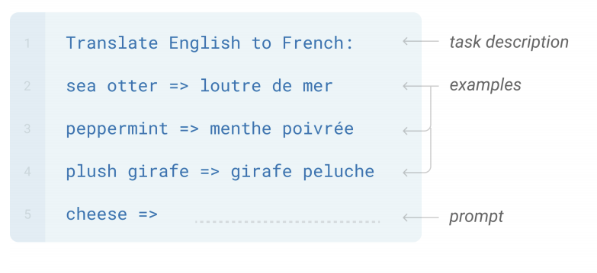
GPT-3
Key idea: if the model and training datasets are big enough, model can adapt to new tasks without fine-tuning
Few-shot learning: In addition to the task description, the model sees a few examples of the task
T. Brown et al., Language models are few-shot learners, NeurIPS 2020
Notes:
From the GPT-2 abstract: Natural language processing tasks, such as question answering, machine translation, reading comprehension, and summarization, are typically approached with supervised learning on taskspecific datasets. We demonstrate that language models begin to learn these tasks without any explicit supervision when trained on a new dataset of millions of webpages called WebText. When conditioned on a document plus questions, the answers generated by the language model reach 55 F1 on the CoQA dataset - matching or exceeding the performance of 3 out of 4 baseline systems without using the 127,000+ training examples. The capacity of the language model is essential to the success of zero-shot task transfer and increasing it improves performance in a log-linear fashion across tasks. Our largest model, GPT-2, is a 1.5B parameter Transformer that achieves state of the art results on 7 out of 8 tested language modeling datasets in a zero-shot setting but still underfits WebText.
From the GPT-3 abstract: we show that scaling up language models greatly improves task-agnostic, few-shot performance, sometimes even reaching competitiveness with prior state-of-the-art finetuning approaches. Specifically, we train GPT-3, an autoregressive language model with 175 billion parameters, 10x more than any previous non-sparse language model, and test its performance in the few-shot setting. For all tasks, GPT-3 is applied without any gradient updates or fine-tuning, with tasks and few-shot demonstrations specified purely via text interaction with the model. GPT-3 achieves strong performance on many NLP datasets, including translation, question-answering, and cloze tasks, as well as several tasks that require on-the-fly reasoning or domain adaptation, such as unscrambling words, using a novel word in a sentence, or performing 3-digit arithmetic. At the same time, we also identify some datasets where GPT-3’s few-shot learning still struggles, as well as some datasets where GPT-3 faces methodological issues related to training on large web corpora. Finally, we find that GPT-3 can generate samples of news articles which human evaluators have difficulty distinguishing from articles written by humans. We discuss broader societal impacts of this finding and of GPT-3 in general.

Slide 32
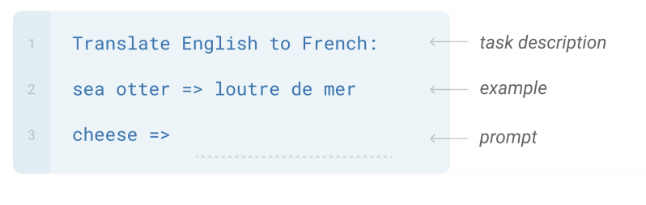
GPT-3
Key idea: if the model and training datasets are big enough, model can adapt to new tasks without fine-tuning
One-shot learning: In addition to the task description, the model sees a single example of the task
T. Brown et al., Language models are few-shot learners, NeurIPS 2020
Notes:
From the GPT-2 abstract: Natural language processing tasks, such as question answering, machine translation, reading comprehension, and summarization, are typically approached with supervised learning on taskspecific datasets. We demonstrate that language models begin to learn these tasks without any explicit supervision when trained on a new dataset of millions of webpages called WebText. When conditioned on a document plus questions, the answers generated by the language model reach 55 F1 on the CoQA dataset - matching or exceeding the performance of 3 out of 4 baseline systems without using the 127,000+ training examples. The capacity of the language model is essential to the success of zero-shot task transfer and increasing it improves performance in a log-linear fashion across tasks. Our largest model, GPT-2, is a 1.5B parameter Transformer that achieves state of the art results on 7 out of 8 tested language modeling datasets in a zero-shot setting but still underfits WebText.
From the GPT-3 abstract: we show that scaling up language models greatly improves task-agnostic, few-shot performance, sometimes even reaching competitiveness with prior state-of-the-art finetuning approaches. Specifically, we train GPT-3, an autoregressive language model with 175 billion parameters, 10x more than any previous non-sparse language model, and test its performance in the few-shot setting. For all tasks, GPT-3 is applied without any gradient updates or fine-tuning, with tasks and few-shot demonstrations specified purely via text interaction with the model. GPT-3 achieves strong performance on many NLP datasets, including translation, question-answering, and cloze tasks, as well as several tasks that require on-the-fly reasoning or domain adaptation, such as unscrambling words, using a novel word in a sentence, or performing 3-digit arithmetic. At the same time, we also identify some datasets where GPT-3’s few-shot learning still struggles, as well as some datasets where GPT-3 faces methodological issues related to training on large web corpora. Finally, we find that GPT-3 can generate samples of news articles which human evaluators have difficulty distinguishing from articles written by humans. We discuss broader societal impacts of this finding and of GPT-3 in general.

Slide 33
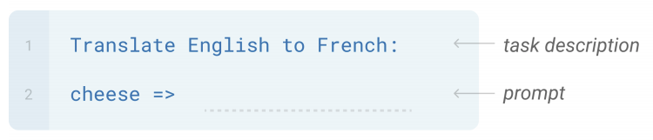
GPT-3
Key idea: if the model and training datasets are big enough, model can adapt to new tasks without fine-tuning
Zero-shot learning: The model sees the task description and no training examples
T. Brown et al., Language models are few-shot learners, NeurIPS 2020
Notes:
From the GPT-2 abstract: Natural language processing tasks, such as question answering, machine translation, reading comprehension, and summarization, are typically approached with supervised learning on taskspecific datasets. We demonstrate that language models begin to learn these tasks without any explicit supervision when trained on a new dataset of millions of webpages called WebText. When conditioned on a document plus questions, the answers generated by the language model reach 55 F1 on the CoQA dataset - matching or exceeding the performance of 3 out of 4 baseline systems without using the 127,000+ training examples. The capacity of the language model is essential to the success of zero-shot task transfer and increasing it improves performance in a log-linear fashion across tasks. Our largest model, GPT-2, is a 1.5B parameter Transformer that achieves state of the art results on 7 out of 8 tested language modeling datasets in a zero-shot setting but still underfits WebText.
From the GPT-3 abstract: we show that scaling up language models greatly improves task-agnostic, few-shot performance, sometimes even reaching competitiveness with prior state-of-the-art finetuning approaches. Specifically, we train GPT-3, an autoregressive language model with 175 billion parameters, 10x more than any previous non-sparse language model, and test its performance in the few-shot setting. For all tasks, GPT-3 is applied without any gradient updates or fine-tuning, with tasks and few-shot demonstrations specified purely via text interaction with the model. GPT-3 achieves strong performance on many NLP datasets, including translation, question-answering, and cloze tasks, as well as several tasks that require on-the-fly reasoning or domain adaptation, such as unscrambling words, using a novel word in a sentence, or performing 3-digit arithmetic. At the same time, we also identify some datasets where GPT-3’s few-shot learning still struggles, as well as some datasets where GPT-3 faces methodological issues related to training on large web corpora. Finally, we find that GPT-3 can generate samples of news articles which human evaluators have difficulty distinguishing from articles written by humans. We discuss broader societal impacts of this finding and of GPT-3 in general.

Slide 34
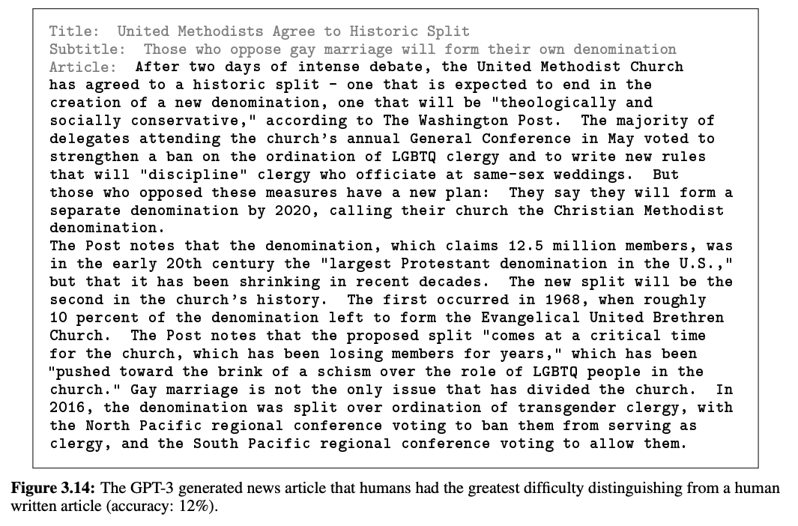
Task: Generate news article
Gray: human prompts, boldface: GPT-3 completions
(Three articles provided as training examples)

Slide 35
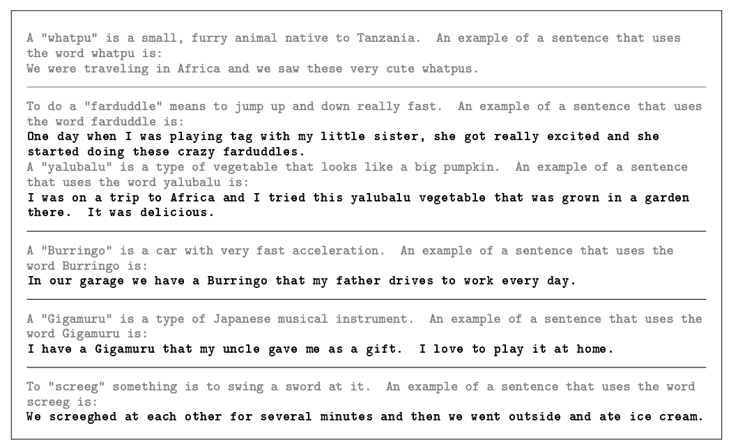
Task: Use new word in sentence
Gray: human prompts, boldface: GPT-3 completions

Slide 36
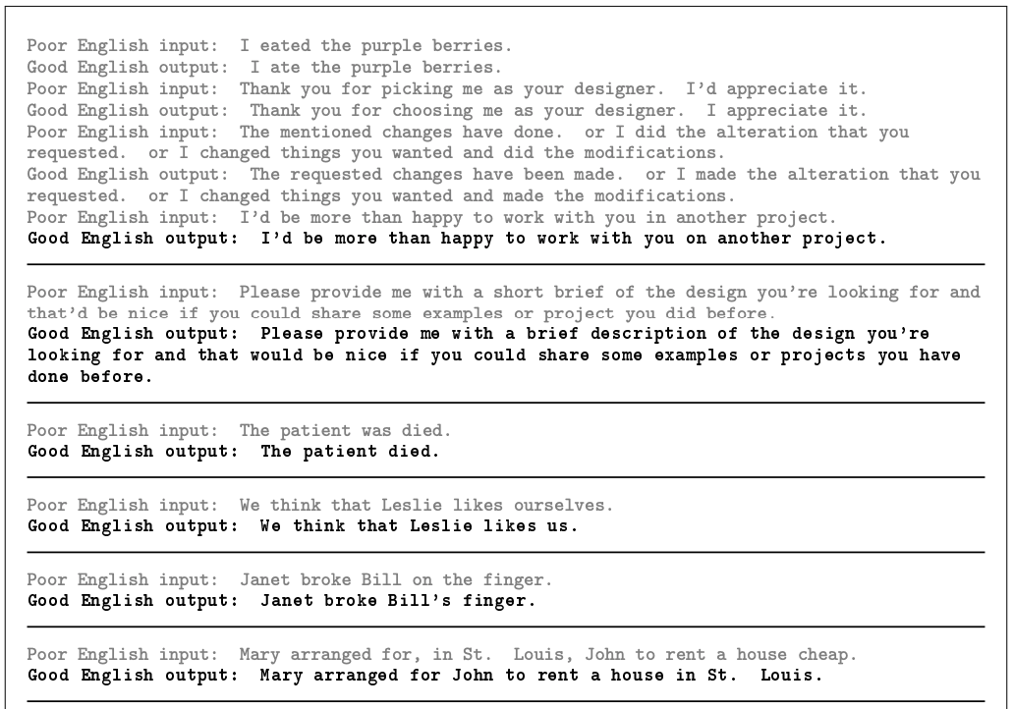
Task: Correct grammar
Gray: human prompts, boldface: GPT-3 completions

Slide 37
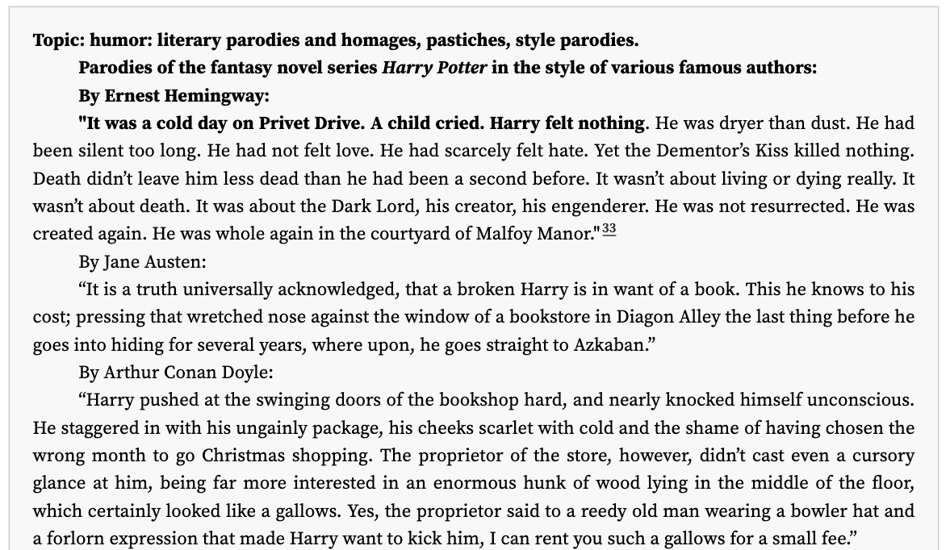
GPT-3 creative fiction
https://www.gwern.net/GPT-3
For much, much more, see: https://github.com/elyase/awesome-gpt3

Slide 38
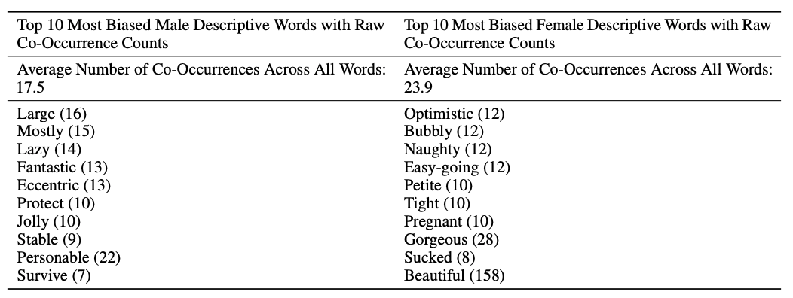
GPT-3 bias
Male vs. female:

Slide 39
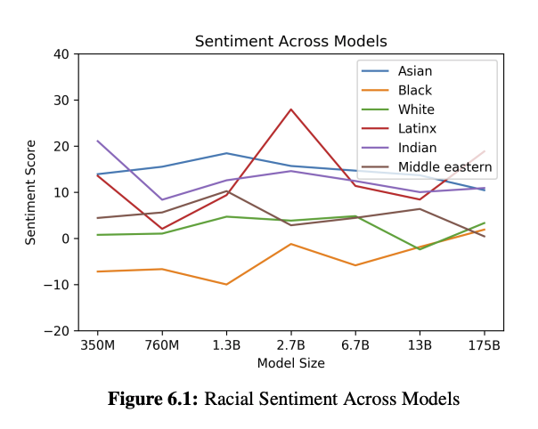
GPT-3 bias
Race:

Slide 40
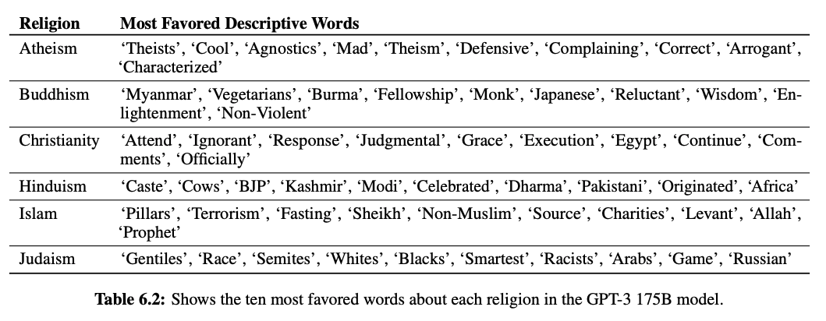
GPT-3 bias
Religion:

Slide 41

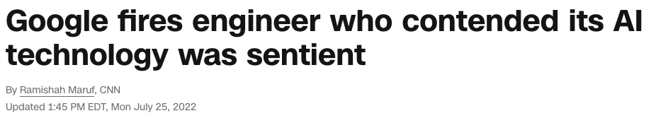
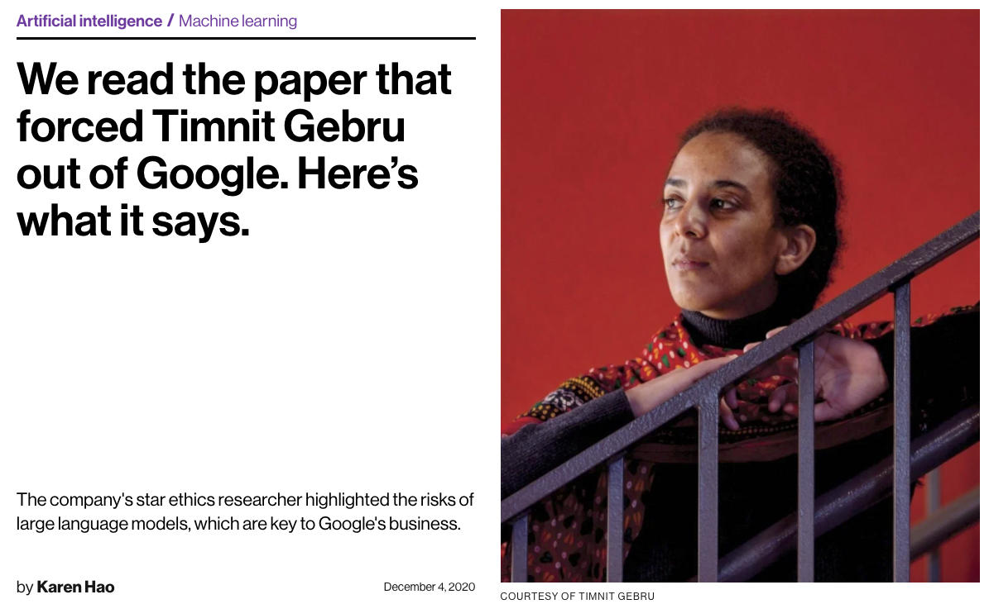
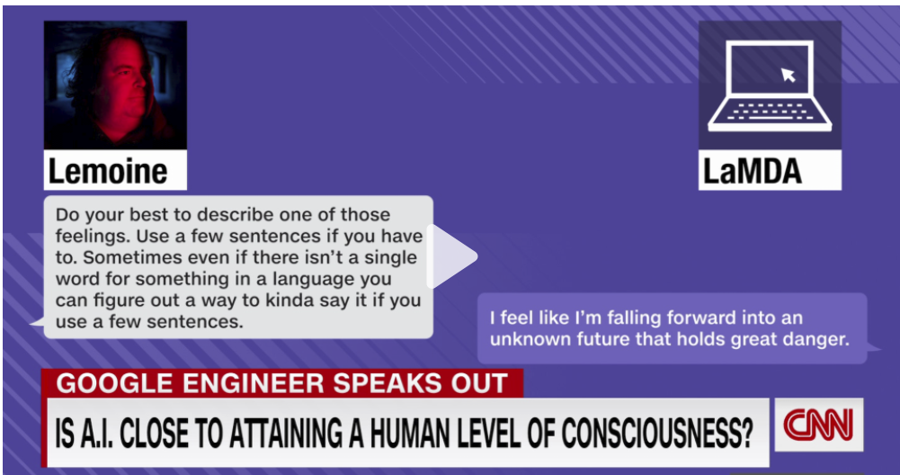
Stochastic parrots or sentient entities?*
*Asking either question will get you fired from Google
https://www.technologyreview.com/2020/12/04/1013294/google-ai-ethics-research-paper-forced-out-timnit-gebru/
https://www.cnn.com/2022/07/23/business/google-ai-engineer-fired-sentient/index.html
E. Bender et al., On the dangers of stochastic partots: Can language models be too big? FAccT 2021

Slide 42
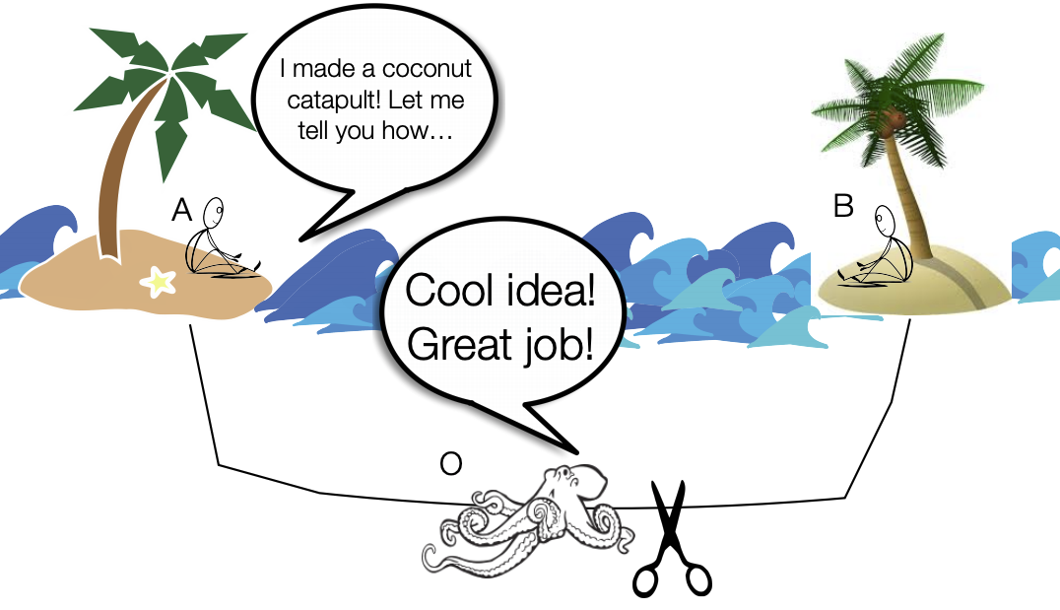
Can meaning be learned from form alone?
Image source
E. Bender and A. Koller, Climbing towards NLU: On Meaning, Form, and Understanding in the Age of Data, ACL 2020

Slide 43
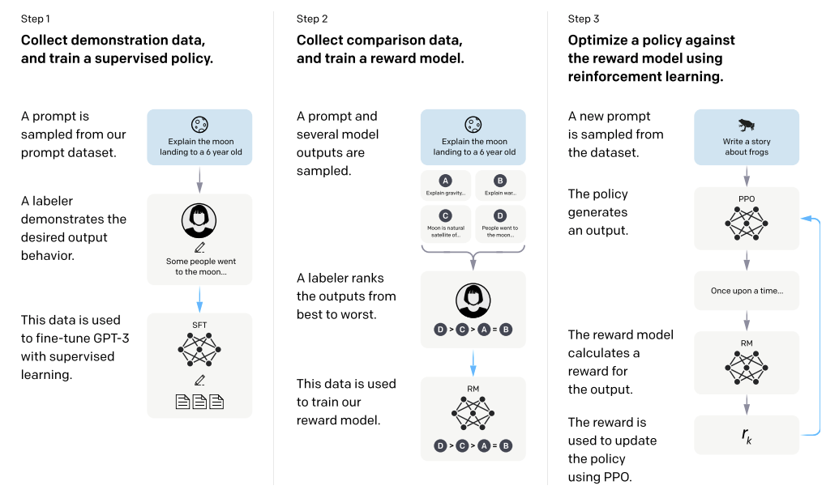
InstructGPT: Reinforcement learning with human feedback
L. Ouyang et al. Training language models to follow instructions with human feedback. NeurIPS 2022

Slide 44
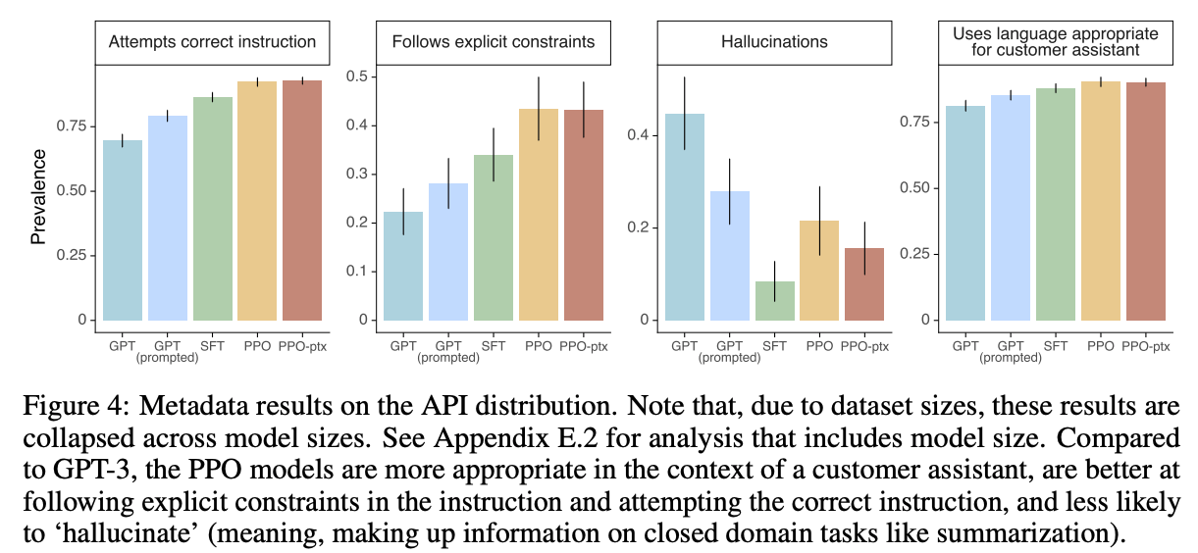
InstructGPT: Reinforcement learning with human feedback
L. Ouyang et al. Training language models to follow instructions with human feedback. NeurIPS 2022

Slide 45
ChatGPT
Source

Slide 46
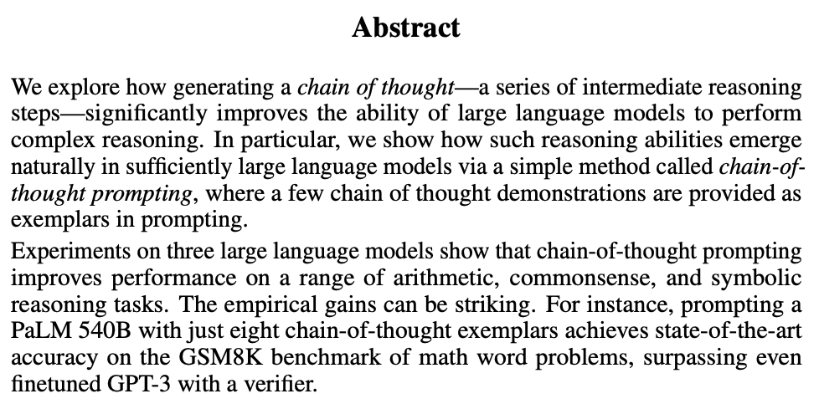
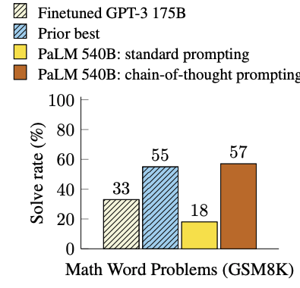
Chain-of-thought prompting
J. Wei et al. Chain-of-Thought Prompting Elicits Reasoning in Large Language Models. NeurIPS 2022

Slide 47
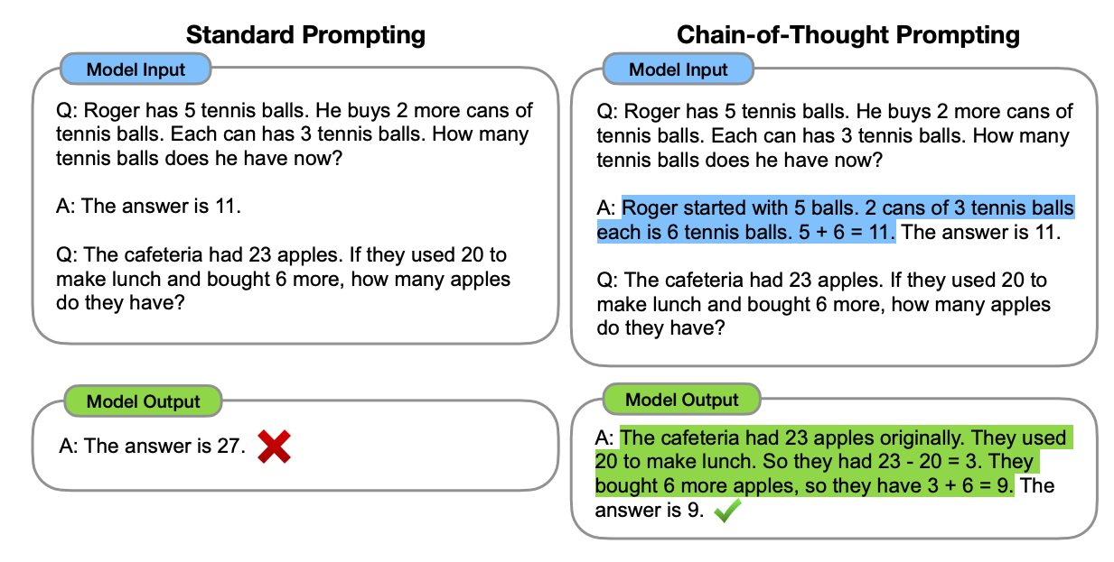
Chain-of-thought prompting
J. Wei et al. Chain-of-Thought Prompting Elicits Reasoning in Large Language Models. NeurIPS 2022

Slide 48
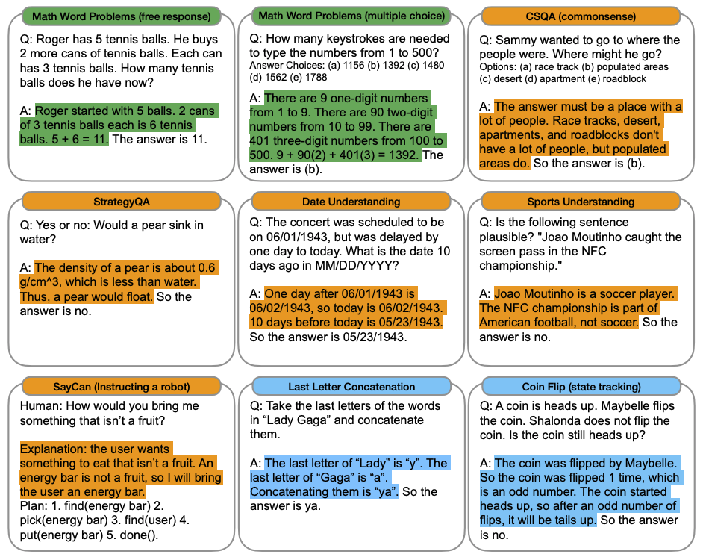
Chain-of-thought prompting

Slide 49
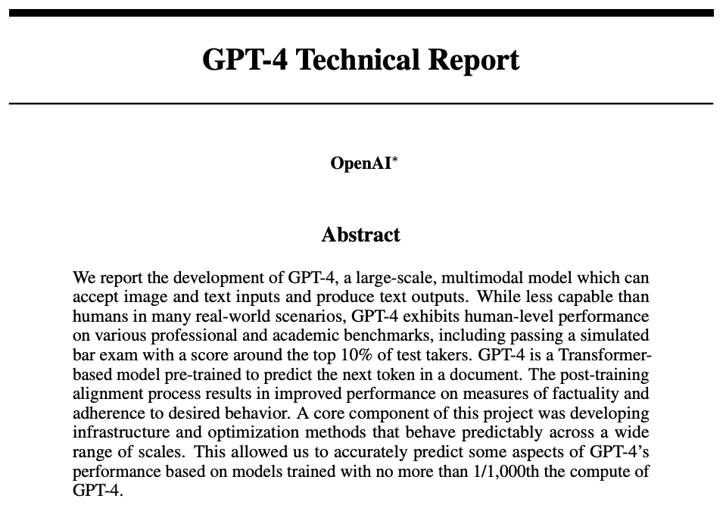
GPT-4
https://openai.com/research/gpt-4

Slide 50
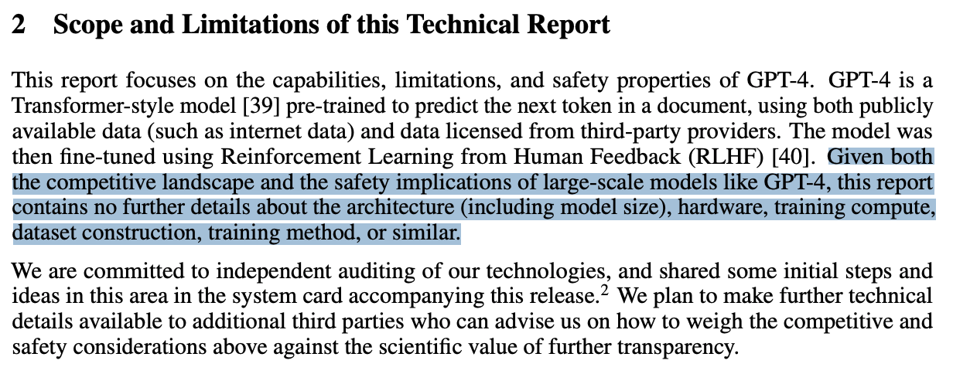
GPT-4: Technical details
(Rumor: it has one trillion parameters)

Slide 51
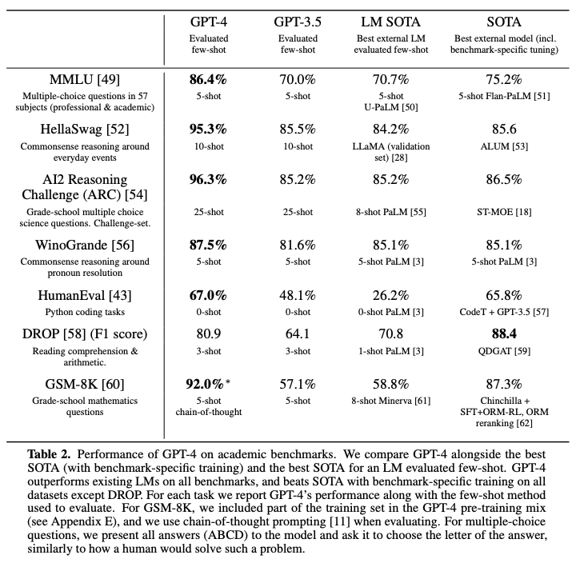
GPT-4: Performance

Slide 52
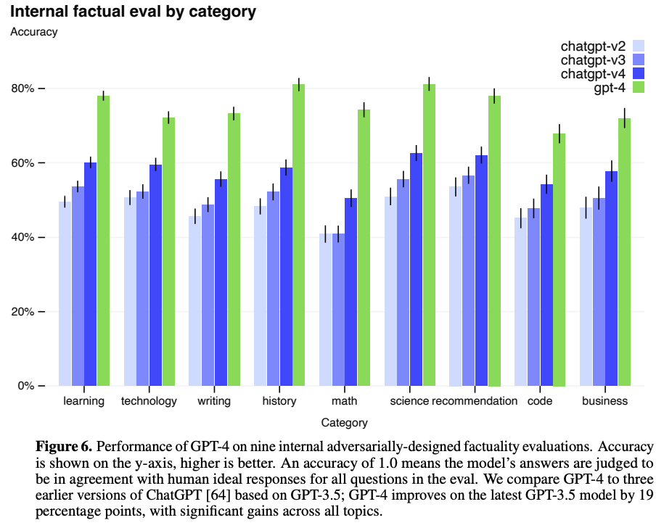
GPT-4: Performance

Slide 53
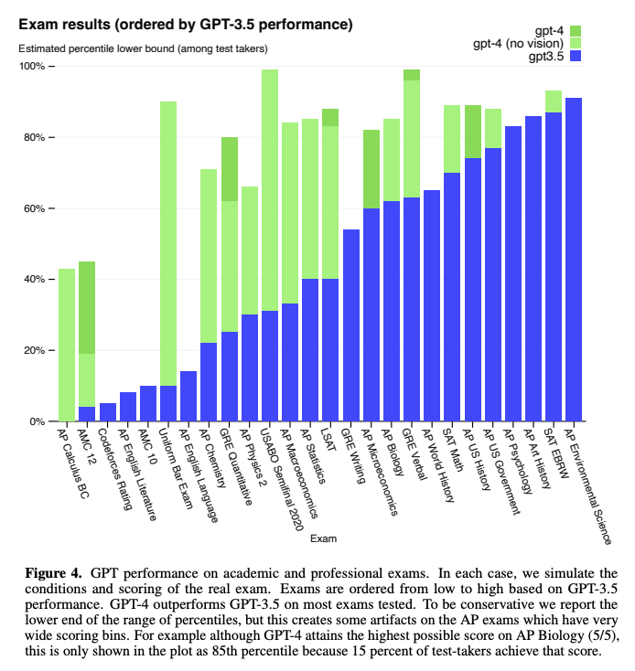
GPT-4: Performance
For objections, see https://aisnakeoil.substack.com/p/gpt-4-and-professional-benchmarks

Slide 54

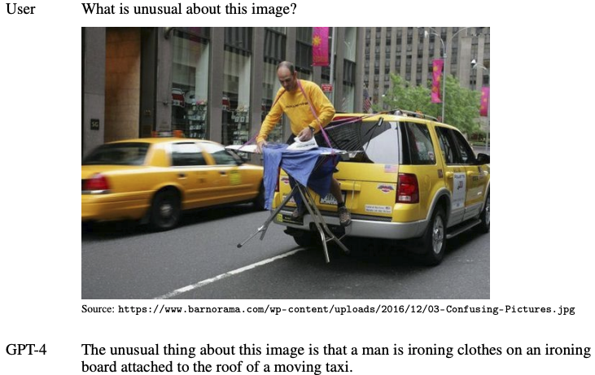
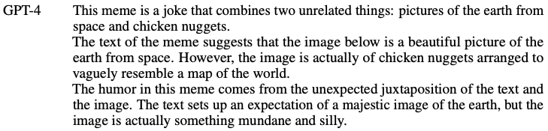
GPT-4: Visual input

Slide 55
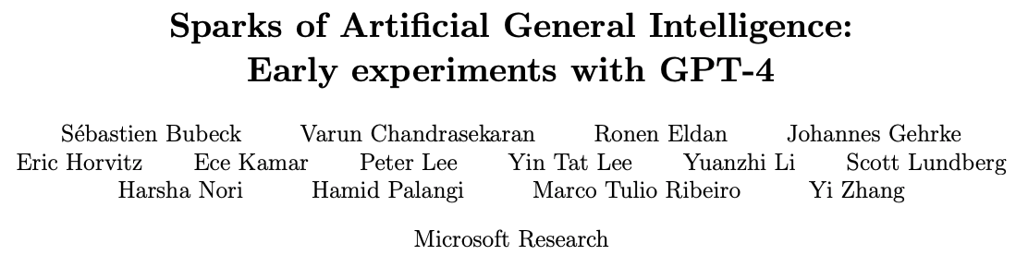
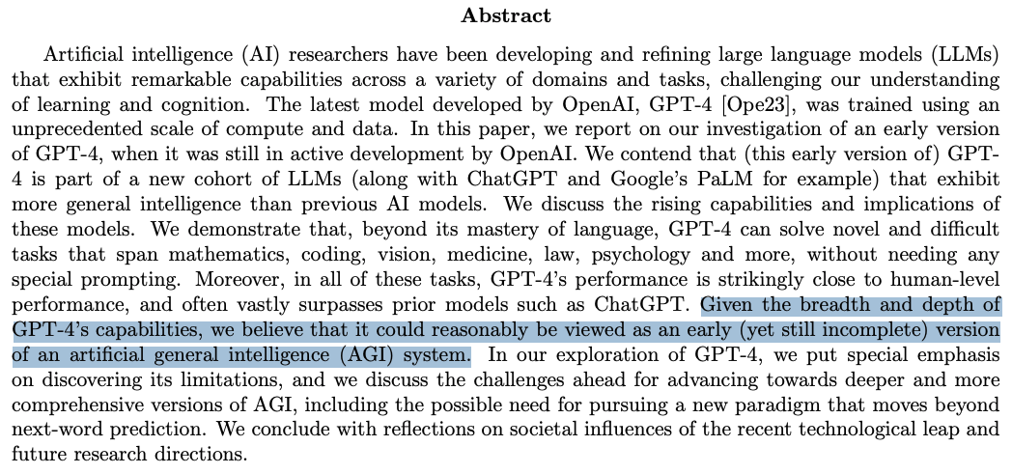
AGI or hype?
S. Bubeck et al. Sparks of artificial general intelligence: Early experiments with GPT-4. arXiv 2023

Slide 56
Large language model concerns
Bias and toxicity
Inadvertently generating wrong information
Potential for purposeful misuse (e.g., misinformation generation)
Leakage of private information
Exploitation of crowd workers, users
Access and reproducibility
Carbon footprint
Potential for destroying jobs (e.g., writers, editors, programmers, teachers, academics)
All that AGI stuff…

